Slide 1
Autonomic Computing
Shafay Shamail
Malik Jahan Khan

Slide 2
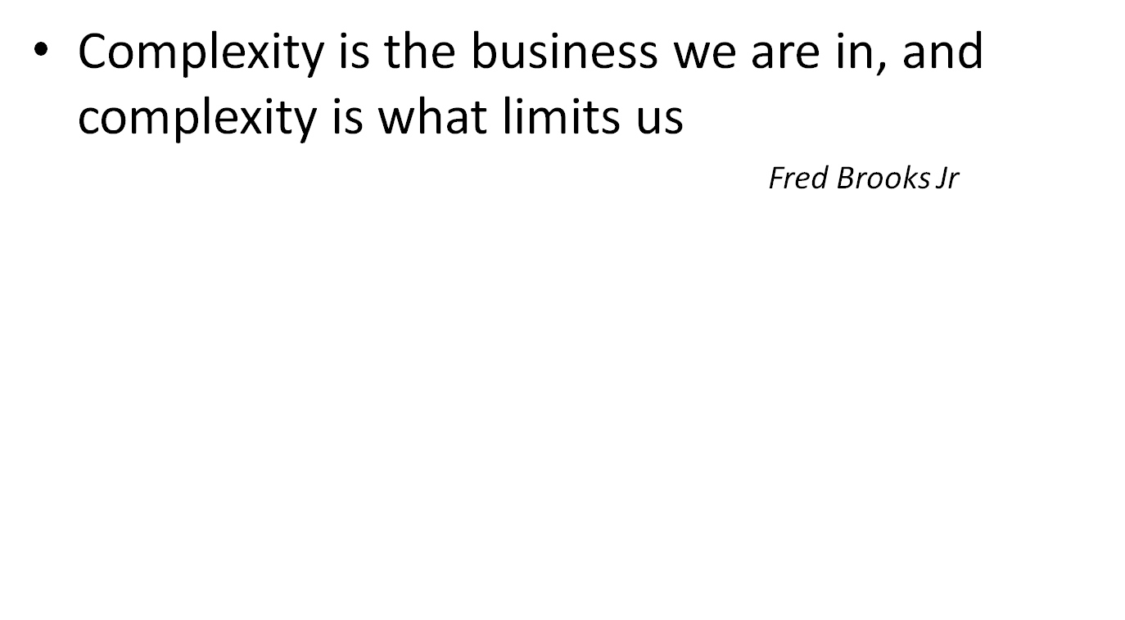

Slide 3
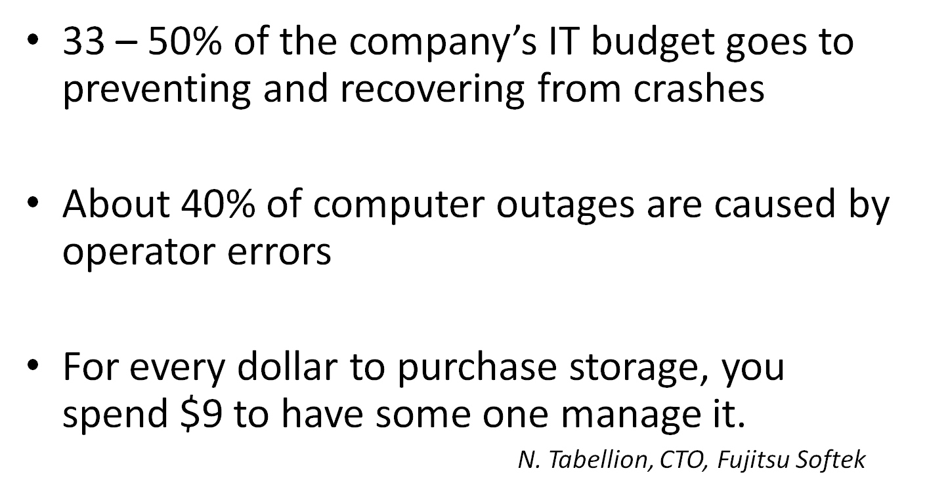

Slide 4
Autonomic Computing
Autonomic Computing: A new research direction in software engineering
  Inspired from nature
  Relatively immature area

Slide 5
Autonomic Systems
Initiative taken by IBM in 2001
Inspiration from biological systems
Increased complexity and human role
Minimizing human intervention
Capability to understand high-level goals
Incorporating self-managing behavior
Autonomic systems are built of autonomic elements
Notes:
IBM, University of California-Berkeley, MIT, University of Texas, University of Michigan, University of Colorado
build computer systems that regulate themselves much in the same way our autonomic nervous system regulates and protects our bodies

Slide 6
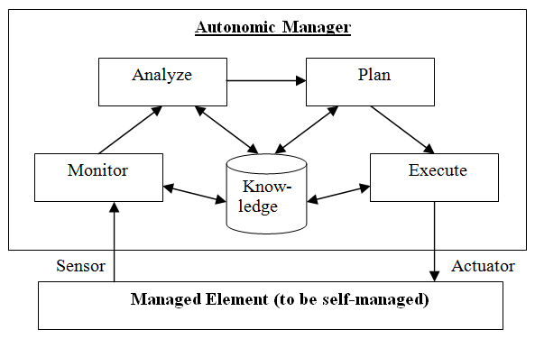
Autonomic Element

Slide 7
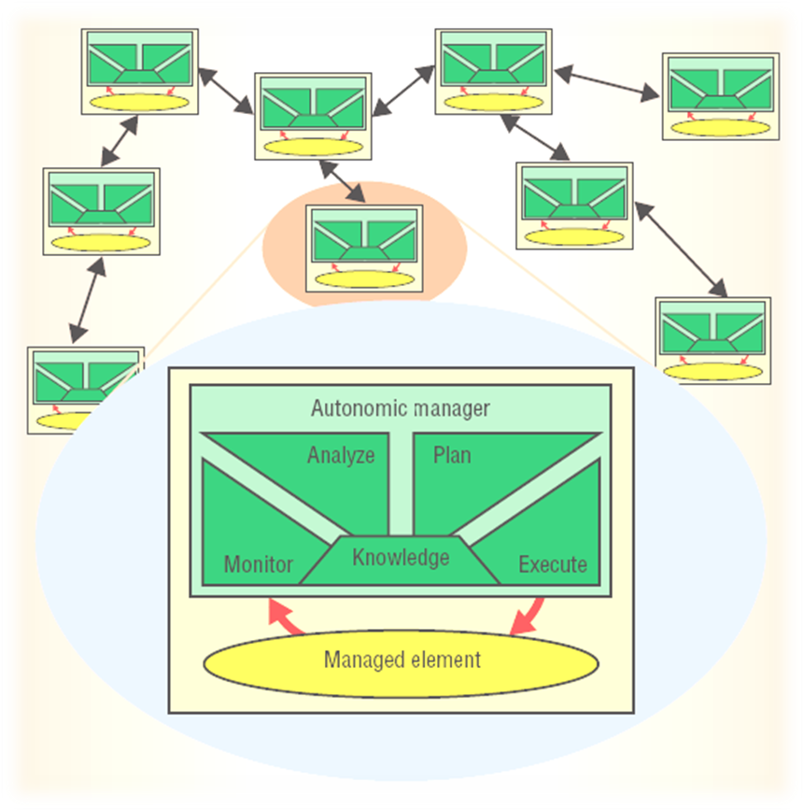
Interaction of Autonomic Elements
Source: J. O. Kephart and D. M. Chess. The vision of autonomic computing. IEEE Computer, pages 41-50, January 2003.

Slide 8
Self-* Properties
Self-configuration
Self-healing
Self-protection
Self-optimization
Self-awareness

Slide 9
Self-Configuration
In human body, when a new cell is generated or an existing cell dies, then this change is adapted seamlessly
With the change in various parameters of the environment, system adjusts itself without disrupting the existing services
Administrator mentions, what is desired, not how to accomplish it, and system performs the task automatically and seamlessly
Examples: Autonomic forest fire application, Astrolabe
Notes:
An autonomic computing system must know its environment and the context surrounding its activity, and act accordingly. It will find and generate rules for how best to interact with neighboring systems. It will tap available resources, even negotiate the use by other systems of its underutilized elements, changing both itself and its environment in the process -- in a word, adapting.
examples

Slide 10
Self-Healing
If a human gets a cut on the body, then it is healed seamlessly
In software, if some problem occurs, then its remedy is provided automatically
Detected problem is diagnosed and repaired
Examples: Online

Slide 11
Self-Protection
Built-in mechanism in human body to protect itself from diseases
In software systems, protective mechanism against the risks arising from some malicious attacks or failure in self-healing process
Example: Secure Distributed Storage (IBM)
Notes:
A virtual world is no less dangerous than the physical one

Slide 12
Self-Optimization
In human, various attributes like blood pressure, pulse rate etc are automatically controlled with changing environment
In software, best possible resource utilization is enables keeping in view the available resources and objectives to be achieved
Example: LEO database optimizer
Notes:
It will monitor its constituent parts and fine-tune workflow to achieve predetermined system goals.

Slide 13
Self-Awareness
Human senses its environment like heat, cold, fire etc and switches to relatively safer state
In software, state consciousness is enabled and state is changed when some safer state is available
Example: QFabric
Notes:
an autonomic system will need detailed knowledge of its components, current status, ultimate capacity, and all connections to other systems to govern itself. It will need to know the extent of its "owned" resources, those it can borrow or lend, and those that can be shared or should be isolated.

Slide 14
Challenges of Autonomic Computing
Rehearsal of Operations and Planning
  Experimentation on actual systems may not be possible
  Test systems should simulate state of actual systems
  Roll back options in case of undesirable configuration
State Awareness
  State transparency
  Mental model of all operations should be captured easily
Multi-Tasking
  Multiple self-properties to be exhibited
  Multiple autonomic managers working simultaneously and their coordination

Slide 15
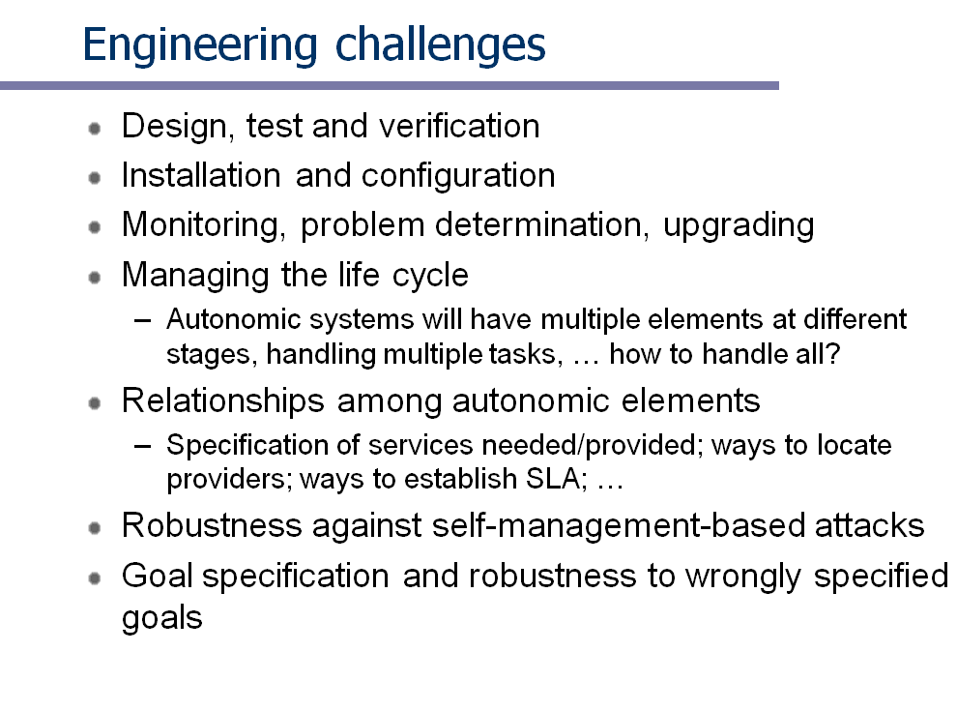

This slide borrowed from Autonomic Computing Course Website of Fabian Bustamante, Northwest University: http://www.cs.northwestern.edu/%7Efabianb/classes/cs-495-w06

Slide 16
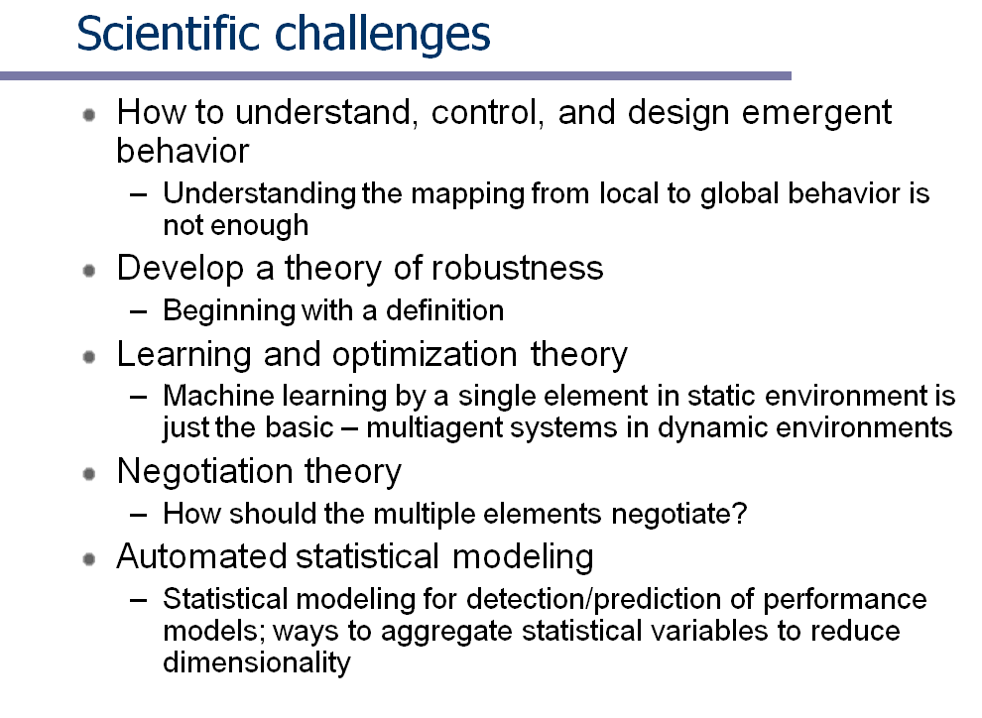
This slide borrowed from Autonomic Computing Course Website of Fabian Bustamante, Northwest University: http://www.cs.northwestern.edu/%7Efabianb/classes/cs-495-w06/schedule.html

